Slide 1

Design & Analysis of Algorithm
CS-503
Computer Science
Lecture 3
Divide and Conquer technique
BY: Bushra Saif

Slide 2
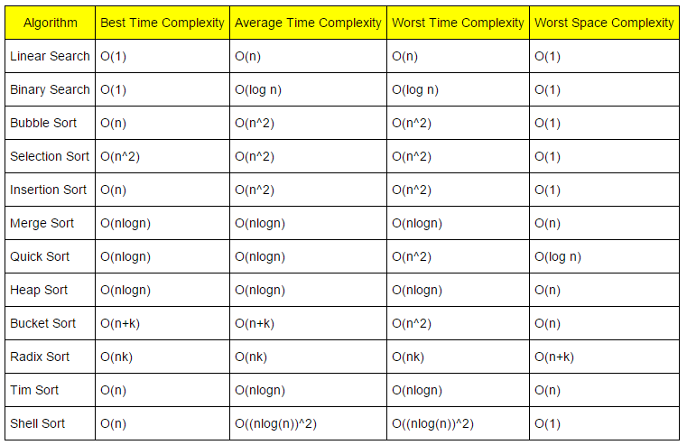
L1.<number>

Slide 3
Divide and Conquer algorithms
“Divide-and-conquer, breaks a problem into sub problems that are similar to the original problem, recursively solves the sub problems, and finally combines the solutions to the sub problems to solve the original problem.“
Because divide-and-conquer solves sub problems recursively, each sub problem must be smaller than the original problem, and there must be a base case for sub problems.
Because divide-and-conquer creates at least two sub problems, a divide-and-conquer algorithm makes multiple recursive calls.
L1.<number>

Slide 4
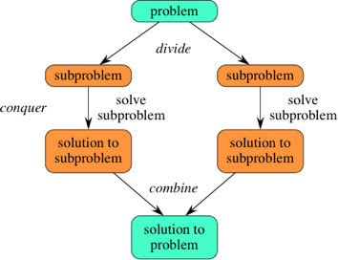
Divide and Conquer algorithms
You should think of a divide-and-conquer algorithm as having three parts:
Divide the problem into a number of sub problems that are smaller instances of the same problem.
Conquer the sub problems by solving them recursively. If they are small enough, solve the sub problems as base cases.
Merge the solutions to the sub problems into the solution for the original problem.
L1.<number>

Slide 5
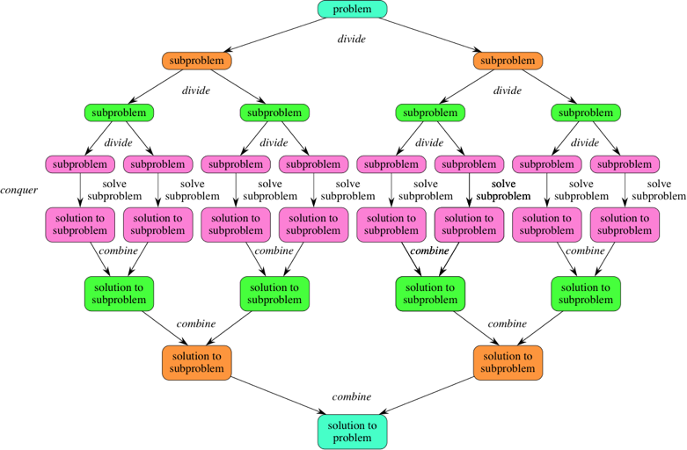
If we expand out two more recursive steps, it looks like this
L1.<number>

Slide 6
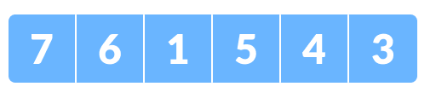
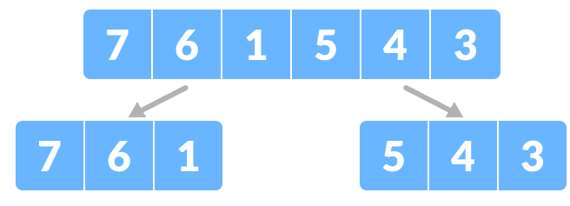
Example
Let us understand this concept with the help of an example. Here, we will sort an array using the divide and conquer approach (i.e.. merge sort).
Let the given array be:
Divide the array into two halves.
Again, divide each subpart recursively into two halves until you get individual elements.
L1.<number>

Slide 7
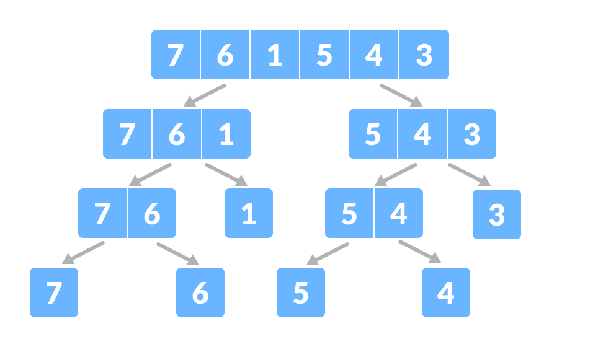
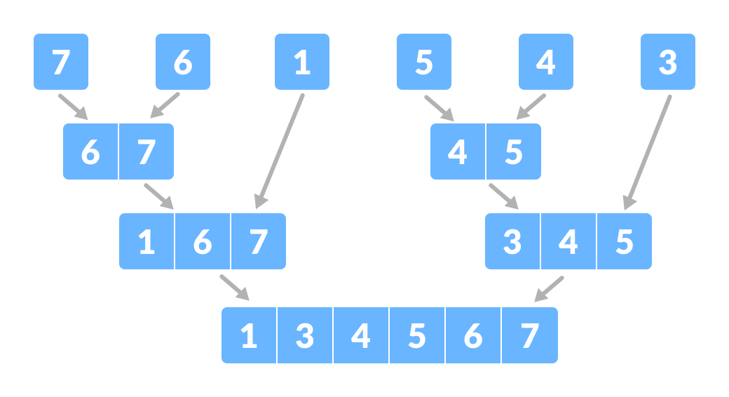
3. Now, combine the individual elements in a sorted manner. Here, conquer and combine steps go side by side.
L1.<number>

Slide 8
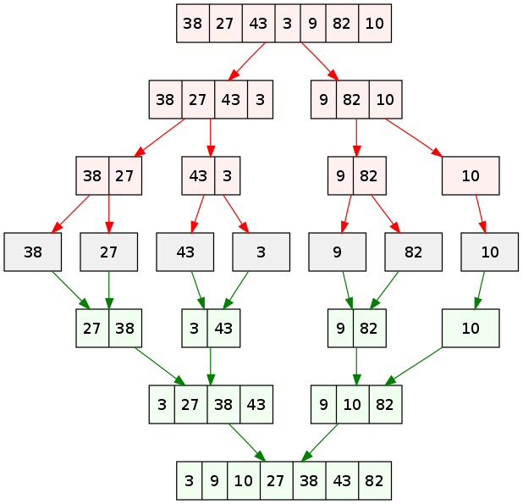
L1.<number>

Slide 9
DAC relation with recurrence
The steps 'Conquer' and 'Merge' work so close that sometimes they are treated as a single step. The Divide and Conquer can be implemented in two ways:
  Naturally i.e. by using recursion
  Explicitly i.e. by using data structures like stack and queues etc.
One of the major characteristics of Divide and Conquer is that the time complexity of its algorithms can be easily calculated by solving recurrence relations and its correctness can be evaluated via Mathematical Induction.
Divide and conquer is a recursion based algorithm. So, it will have a recurrence relation that mathematically defines its behavior.
L1.<number>

Slide 10
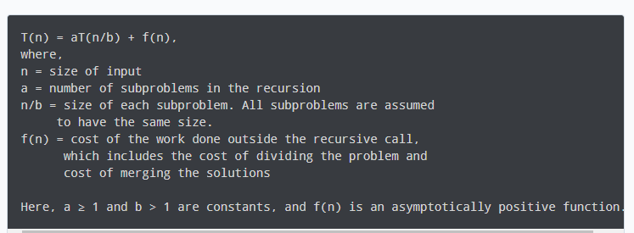
Master Theorem
The master theorem is used in calculating the time complexity of recurrence (functional calling itself) relations (divide and conquer algorithms) in a simple and quick way.
The master method is a formula for solving recurrence relations of the form:
An asymptotically positive function means that for a sufficiently large value of n, we have f(n) > 0
L1.<number>

Slide 11
Master Theorem
Master Method is a direct way to get the solution. The master method works only for following type of recurrences or for recurrences that can be transformed to following type.
T(n) = aT(n/b) + f(n) where a > = 1 and b > 1
Case 1: f(n) < n ^ log(a) [base b]
Time Complexity = Θ (n ^ log(a) [base b])
Case 2: f(n) = n ^ log(a) [base b]
Time Complexity = Θ ((n ^log(a) [base b])* log(n) )
Case 3: f(n) > n ^ log(a) [base b]
Time Complexity = Θ f(n)
L1.<number>

Slide 12
Master Theorem - examples
Lets solve some problems to find complexities using master theorem
Ex#1: T(n)= 4T (n/2)+n
Ex#2: T(n)= 2T (n/2)+n
Solution will be discussed in class.
Ex#3: T(n)= 3T (n/2)+n
Ex#4: T(n)= 16^{n}T (n/3)+1/n
Example 3 and 4 are your assignment no. 1
L1.<number>

Slide 13
Master Theorem limitations
The master theorem cannot be used if:
T(n) is not monotone like T(n) = sin n
f(n) is not a polynomial. eg. f(n) = 2^{n}
a is not a constant. eg. a = 2n
a < 1
It is not necessary that a recurrence of the form T(n) = aT(n/b) + f(n) can be solved using Master Theorem. The given three cases have some gaps between them. For example, the recurrence T(n) = 2T(n/2) + n/Logn cannot be solved using master method.
L1.<number>

Slide 14
Advantages of DAC Algorithm
The complexity for the multiplication of two matrices using the naive method is O(n³), whereas using the divide and conquer approach (i.e. Strassen's matrix multiplication) is O(n^{2.8074}). This approach also simplifies other problems, such as the Tower of Hanoi.
This approach is suitable for multiprocessing systems because Divide and conquer approach supports parallelism as sub-problems are independent. Hence, an algorithm, which is designed using this technique, can run on the multiprocessor system or in different machines simultaneously.
It makes efficient use of memory caches.
In this approach, most of the algorithms are designed using recursion, hence memory management is very high. For recursive function stack is used, where function state needs to be stored.
L1.<number>

Slide 15
Disadvantages of DAC Algorithm
Divide and Conquer strategy uses recursion that makes it a little slower and if a little error occurs in the code the program may enter into an infinite loop.
Usage of explicit stacks may make use of extra space.
If performing a recursion for no. times greater than the stack in the CPU than the system may crash.
Choosing base cases is also a limitation as picking small cases may work if the cases are taken much higher than the capacity of the system than problems may occur.
Sometimes a case where the problem when broken down results in same sub problems which may needlessly increase the solving time and extra space may be consumed.
L1.<number>

Slide 16
Applications of DAC Algorithm
Binary Search
Merge Sort
Quick Sort
Closest Pair of Points
Strassen’s Multiplication
Karatsuba Algorithm
Cooley-Tukey Algorithm
Defective chessboard
Finding the maximum and minimum in an array
L1.<number>

Slide 17
Dynamic programming
Dynamic programming divides the main problem into smaller sub problems, but it does not solve the sub problems independently.
Dynamic Programming is a technique for solving problems with overlapping sub problems. Each sub-problem is solved only once and the result of each sub-problem is stored in a table ( generally implemented as an array or a hash table) for future references. These sub-solutions may be used to obtain the original solution and the technique of storing the sub-problem solutions is known as memorization.
Before solving the current sub problem, it checks the results of the previous sub problems. Finally, it checks the results of all sub problems to find the best solution or the optimal solution. This method is effective as it does not compute the answers again and again. Usually, dynamic programming is used for optimization.
L1.<number>

Slide 18
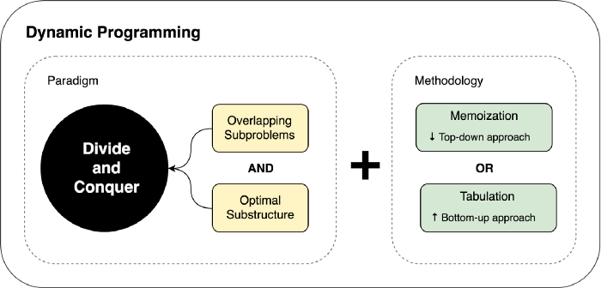
Dynamic programming
Optimal substructure — optimal solution can be constructed from optimal solutions of its sub problems
Overlapping sub-problems — problem can be broken down into sub problems which are reused several times or a recursive algorithm for the problem solves the same sub problem over and over rather than always generating new sub problems
L1.<number>

Slide 19

Dynamic programming example
we’re taking the Fibonacci number problem, and we’ll discuss how it can be solved using the dynamic programming approach. The Fibonacci function can be expressed mathematically as follows:
Here, n is the user input. To illustrate how the Fibonacci function can be solved using the dynamic programming approach, we’re taking the input value n=5. In the first phase, we divide the original problem into sub-problems. Unlike divide and conquer, it computes the sub-problems iteratively and stores the solutions for future use.
Finally, we combine the solutions of the sub-problems to achieve the solution of the main problem:
L1.<number>

Slide 20
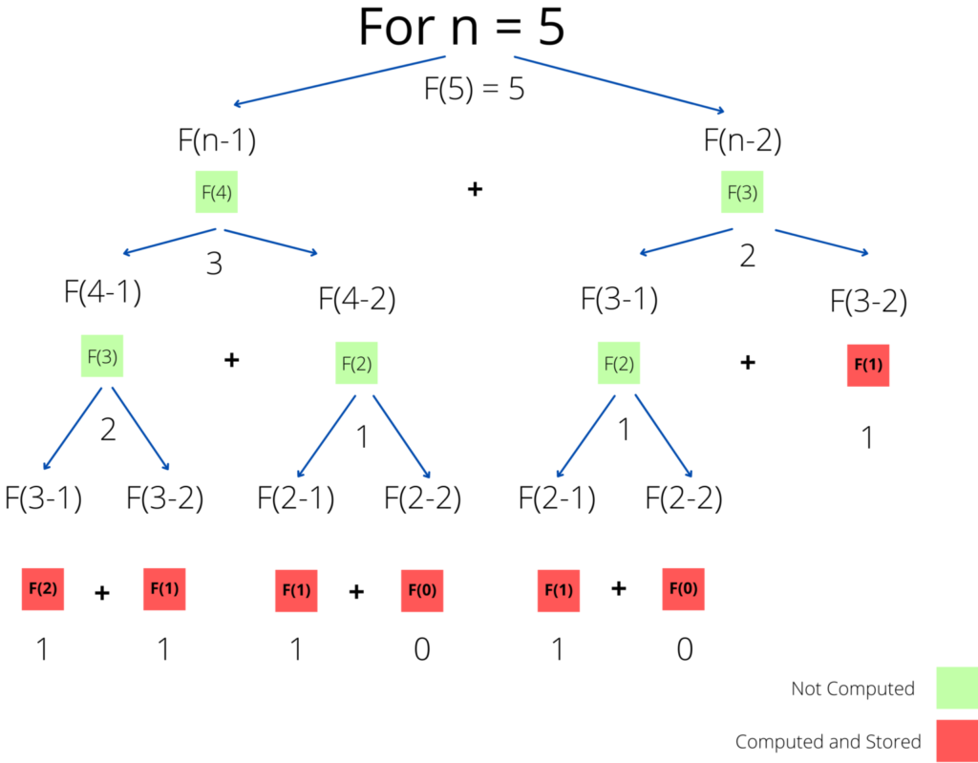
L1.<number>

Slide 21
L1.<number>

Slide 22
DAC algorithm vs dynamic programming
The main difference between divide and conquer and dynamic programming is that the divide and conquer combines the solutions of the sub-problems to obtain the solution of the main problem while dynamic programming uses the result of the sub-problems to find the optimum solution of the main problem.
Divide and conquer algorithm divides the problem into sub problems and combines those solutions to find the solution to the original problem. However, dynamic programming does not solve the sub problems independently. It stores the answers of sub problems to use them for similar problems.
L1.<number>

Slide 23
DAC algorithm vs dynamic programming
Divide and conquer is an algorithm that recursively breaks down a problem into two or more sub-problems of the same or related type until it becomes simple enough to be solved directly. However, dynamic programming is an algorithm that helps to efficiently solve a class of problems that have overlapping sub problems and optimal substructure property.
Time consumption is another difference between divide and conquer and dynamic programming. Divide and conquer solves each sub problem independently. Therefore, it is more time-consuming. Dynamic programming, on the other hand, uses the answers of the previous sub problems. Thus, it is less time-consuming.
L1.<number>

Slide 24
DAC algorithm vs dynamic programming
Divide and conquer is an algorithm that recursively breaks down a problem into two or more sub-problems of the same or related type until it becomes simple enough to be solved directly. However, dynamic programming is an algorithm that helps to efficiently solve a class of problems that have overlapping sub problems and optimal substructure property.
Time consumption is another difference between divide and conquer and dynamic programming. Divide and conquer solves each sub problem independently. Therefore, it is more time-consuming. Dynamic programming, on the other hand, uses the answers of the previous sub problems. Thus, it is less time-consuming.
L1.<number>

Slide 25
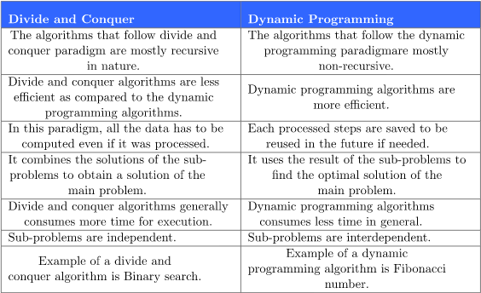
L1.<number>

